Slide 1

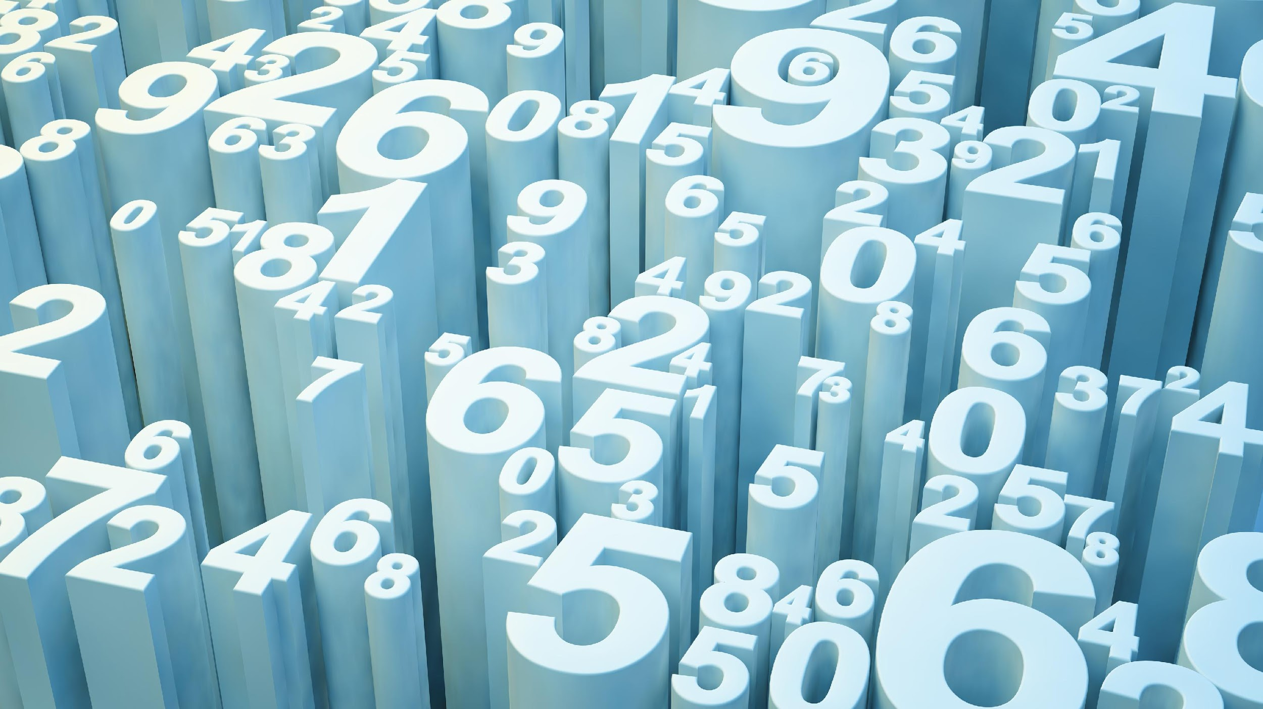
Data Science
She Became

Slide 2
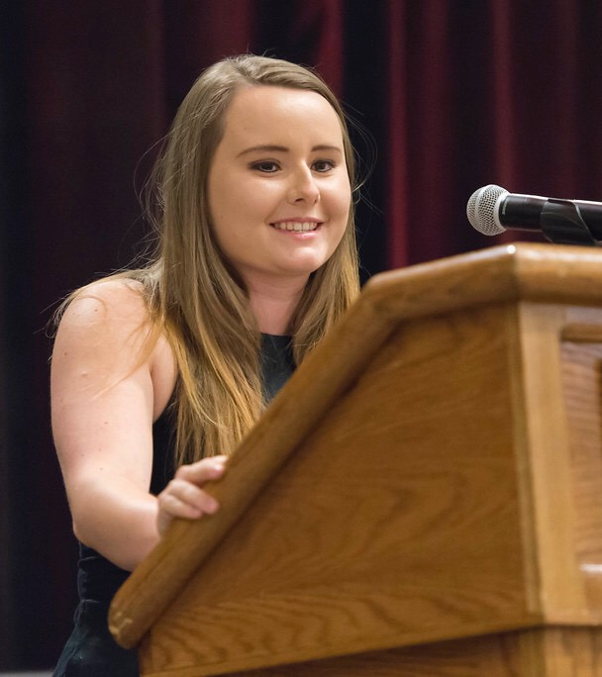

About Me
Hometown: I am originally from Northern Kentucky but have lived in Louisville for 5 years now!
Schooling: I have two bachelor’s degrees from UofL, one in Economics and another in Spanish with a minor in International Business. I just recently graduated with my master’s degree in Business Analytics last month, also from UofL! While I was in school for my master’s degree, I was elected President of my class.
Work: I have worked at LG&E and KU for almost 3 years now.
Hobbies: I love to cook and take care of my house plants!

Slide 3



What is a Data Scientist?
Computer Programmer
Mathematician
Storyteller
Uses various computer programming languages gather and edit data.
Uses math and statistics to solve a wide variety of problems.
Makes the results easy to understand for others.

Slide 4




My Career Journey
I started having an interest in analytics when I was working an internship in Human Resources.
Typically when people think of HR, they think of job interviews. But what I did was completely different, and I loved it.
I studied questions like: Why are people leaving the company? Do we do enough to recruit females and minorities to work for us? How much money should this person be paid?
I discovered that I wanted a career in data science, but had no computer programming experience. So, I went back to school to learn the skills I was missing!

Slide 5
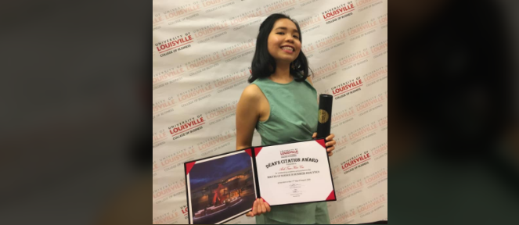
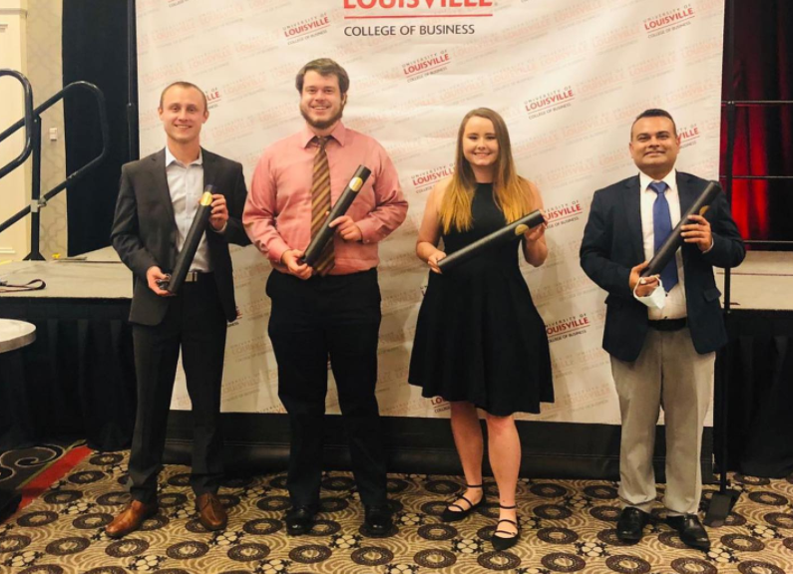
Being a woman in Data Science
I feel empowered.
I found my voice.
I am always one of the only women on my team, which is both challenging and fun. But I have learned that although some people might try to make you feel like you don’t belong, there are a few good men who will push and encourage you every step of the way! Being the only woman allows me to stand out and bring different perspectives to the table.
My boss and teammates trust me to solve problems that impact the decisions our company makes. This career has given me the confidence and skillset needed to drive change in my company. I am constantly learning new technologies and programming languages that I can use to further develop my career.

Slide 6
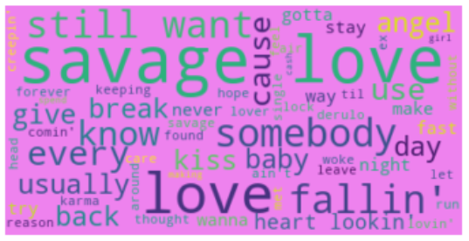
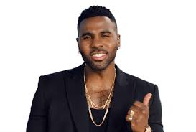
What do I DO all day?
I use math and statistics to make data easy and fun for others to understand!
This picture is called a Word Cloud. I made it using the lyrics to “Savage Love” by Jason Derulo.
The more times a word is mentioned in the song, the bigger it gets in the picture.
Of course the title is big because it is mentioned over and over again. But what other words do you notice? Do these words help tell the viewer what the song is about?
Jason approved!

Slide 7
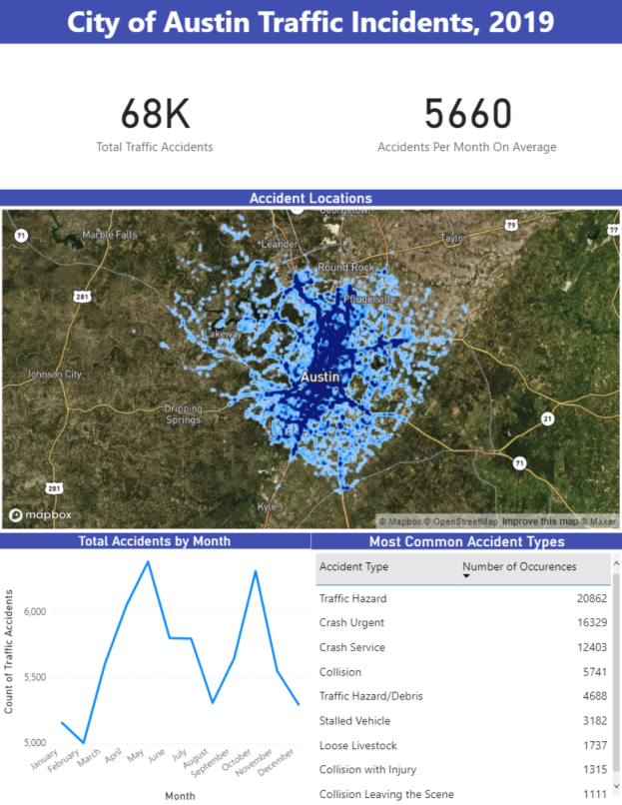
What do I DO all day?
I identify trends in the data and try to figure out what caused them.
This is an example of a dashboard. It shows car accident patterns in Austin, Texas last year.
Dashboards are becoming increasingly popular because they are interactive and can provide a lot of customization. You may have seen something similar on Spotify at the end of last year!

Slide 8

Common Questions
How much money does a Data Scientist make? On average, data scientist make around $113,000 annually. This changes by location, specialty, and years of experience.
What education do I need? 91% of Data Scientists have a Master’s degree or PhD. Data Scientists are lifelong learners and often obtain many tech certifications and learn new programming languages and technologies during their career (hello, Artificial Intelligence!).
What should I study? Data Scientists can come from a diverse set of fields, but the most common are Computer Science, Engineering, Math, Economics, and Statistics.
What percent of Data Scientists are women? Sadly, only 18% of Data Scientists are women, and 11% of Data Science teams have ZERO women at all! Which is why we need YOU to change that! ☺

